Slide 1
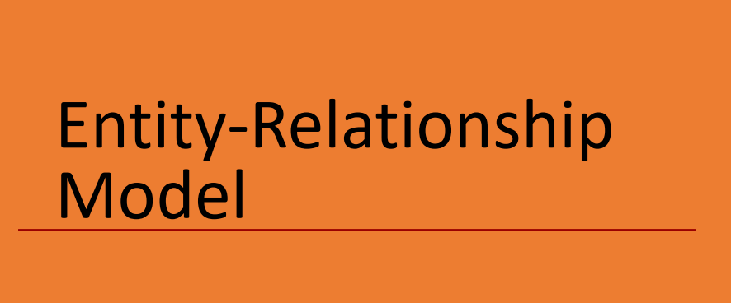

Slide 2
E-R Model

Slide 3
Basic concept of E-R diagram
Basic concepts
What is Database Design?
Database Design is a collection of processes that facilitate the designing, development, implementation and maintenance of enterprise database management systems.
What is E-R diagram?
E-R diagram: (Entity-Relationship diagram)
The ER data model was developed to facilitate database design by allowing specification of an enterprise schema that represents the overall logical structure of a database.
The ER data model employs three basic concepts:
entity sets,
relationship sets,
attributes.
The ER model also has an associated diagrammatic representation, the ER diagram, which can express the overall logical structure of a database graphically.

Slide 4
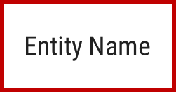



E-R diagram
Entity
An entity is an object that exists and is distinguishable from other objects.
An entity is a person, a place or an object.
An entity is represented by a rectangle which contains the name of an entity.
Entities of a college database are:
Student
Professor/Faculty
Course
Department
Result
Class
Subject
Exercise: List the different entities of bank database. List the different entities of hospital database.

Slide 5
Entity:
Tangible Entity: Tangible Entities are those entities which exist in the real world physically that can be touched, seen, or measured.
Example: Person, car, buildings etc.
Intangible Entity: Intangible Entities are those entities which exist only logically and have no physical existence.
Example: Bank Account, login information etc.

Slide 6
Entity Set
An entity set is a set of entities of the same type that share the same properties.
Example:
All persons having an account in a bank
All the students studying in a college
All the professors working in a college
Set of all accounts in a bank

Slide 7
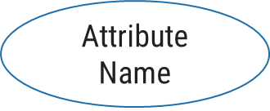
E-R diagram
Attributes
Attribute is properties or details about an entity.
An attribute is represented by an oval containing name of an attribute.
Attributes of Student are:
Roll No
Student Name
Branch
Semester
Address
Mobile No
Age
SPI
Backlogs
RollNo
Name
Student
Exercise
Write down the different attributes of Faculty entity.
Exercise
Write down the different attributes of Account entity.

Slide 8

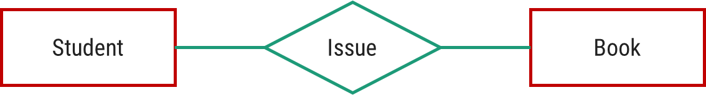
E-R diagram
Relationship
Relationship is an association (connection) between several entities.
It should be placed between two entities and a line connecting it to an entity.
A relationship is represented by a diamond containing relationship's name.

Slide 9
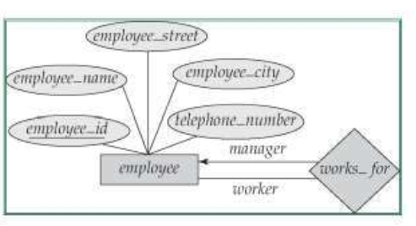
Degree of a Relationship
A Relationship represents an association between two or more entities.
Relationships are classified in terms of degree, connectivity, cardinality, and existence.
The degree of a relationship is the number of entities associated with the relationship.
The n-ary relationship is the general form for degree n.
Special cases are the binary, and ternary, where the degree is 2, and 3, respectively
A recursive binary relationship occurs when an entity is related to itself.
Example:
"some employees are married to other employees".
“Employee work_for a manager who is also an employee.

Slide 10
E-R diagram
E-R Diagram of a Library System
Primary Key
Primary Key
Attributes
RollNo
Name
Relationship
BookNo
Name
Student
Issue
Book
Branch
Sem
Entities
Author
Price

Slide 11
E-R diagram
Ternary Relationship
ProjectID
Project Name
Project
FacID
Name
RollNo
Name
Faculty
Guide
Student
Branch
Technology
Branch
Sem

Slide 12



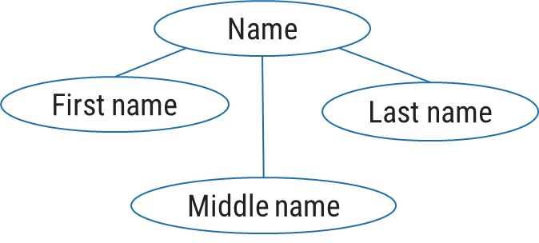
E-R diagram
Types of Attributes
Simple Attribute
Cannot be divided into subparts
E.g. RollNo, Age
Composite Attribute
Can be divided into subparts
Name
(first name, middle name, last name)
Address
(street, road, city)

Slide 13

E-R diagram
Types of Attributes
Single-valued Attribute
Has single value
E.g. RollNo, Age
Multi-valued Attribute
Has multiple (more than one) value
PhoneNo
(person may have multiple phone nos)
Email_ID
(person may have multiple emails)

Slide 14


E-R diagram
Types of Attributes
Stored Attribute
It’s value is stored physically in the database
E.g. Birthdate
Derived Attribute
It’s value is derived or calculated from other attributes
Age
(can be calculated using current date and birthdate)

Slide 15
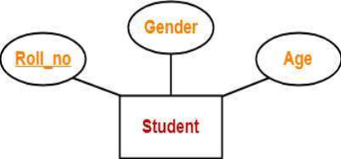
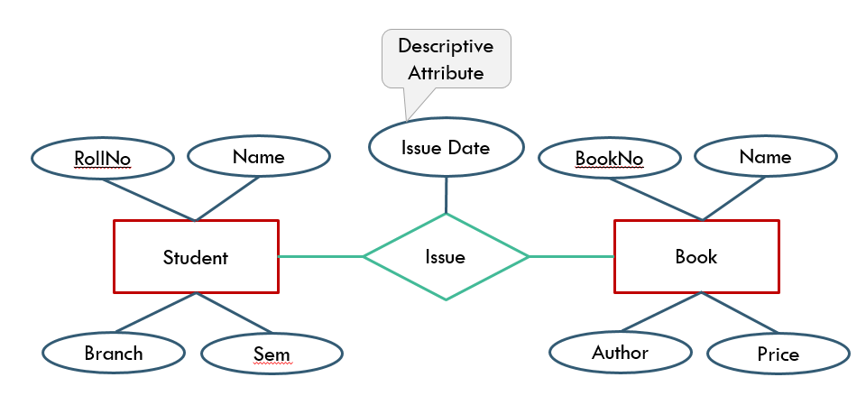
E-R diagram
Types of Attributes
Key Attribute:
Key attributes are those attributes which can identify an entity uniquely in an entity set.
Example: Roll_no.
Descriptive Attribute: Attributes of the relationship is called descriptive attribute.

Slide 16
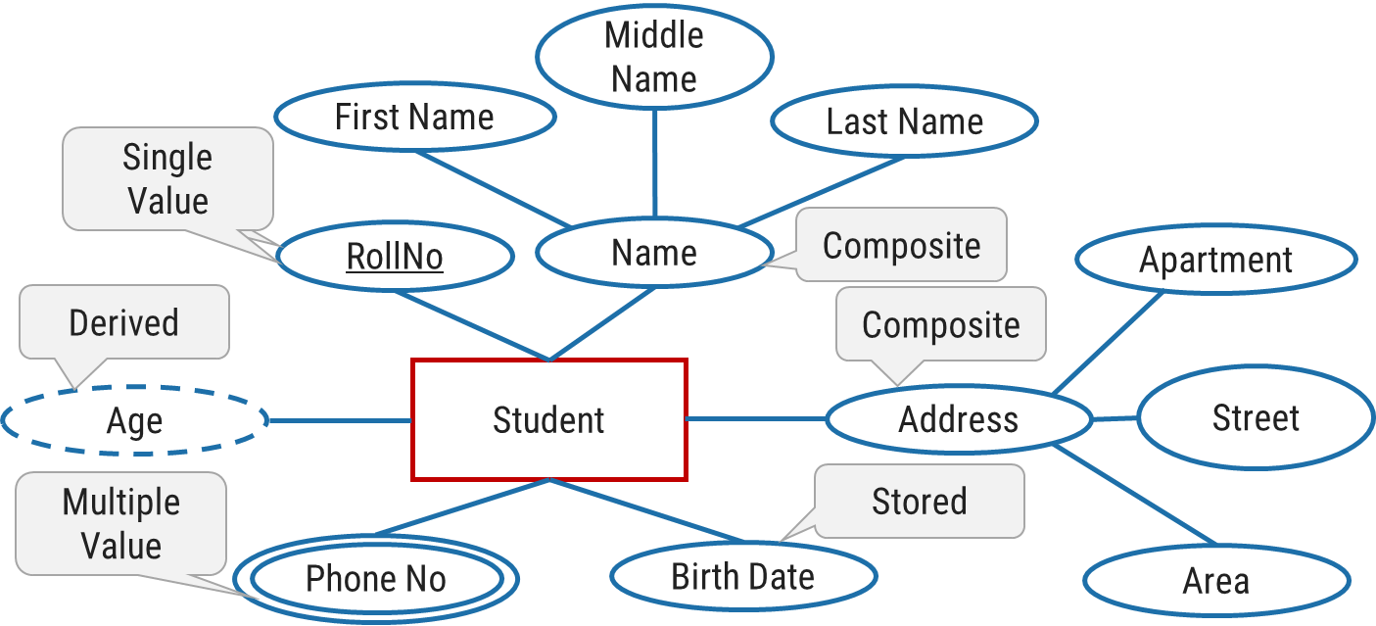
E-R diagram
Entity with all types of Attributes

Slide 17
Exercise
Draw an E-R diagram of following pair of entities
Customer & Account
Customer & Loan
Doctor & Patient
Student & Project
Student & Teacher
Note: Take four attributes per entity with one primary key attribute.
Keep proper relationship between two entities.

Slide 18
Mapping Cardinality (Cardinality Constraints)
It represents the number of entities of another entity set which are connected to an entity using a relationship set.
It is most useful in describing binary relationship sets.
For a binary relationship set the mapping cardinality must be one of the following types:
One to One
One to Many
Many to One
Many to Many

Slide 19
One-to-One relationship (1 – 1)
An entity in A is associated with only one entity in B and an entity in B is associated with only one entity in A.
Example: A customer is connected with only one loan using the relationship borrower and a loan is connected with only one customer using borrower.
customer
borrow
loan
A1
B1
C1
L1
A2
B2
C2
L2
C3
L3
A
B

Slide 20
One-to-Many relationship (1 – N)
An entity in A is associated with more than one entities in B and an entity in B is associated with only one entity in A.
Example: A loan is connected with only one customer using borrower and a customer is connected with more than one loans using borrower.
customer
borrow
loan
A1
B1
C1
L1
A2
B2
C2
L2
C3
L3
A
B
L4

Slide 21
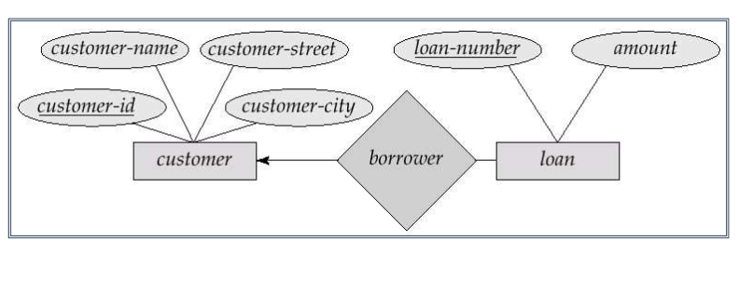
One-to-Many relationship (1 – N)

Slide 22
Many-to-One relationship (N – 1)
An entity in A is associated with only one entity in B and an entity in B is associated with more than one entities in A.
Example: A loan is connected with more than one customer using borrower and a customer is connected with only one loan using borrower.
customer
borrow
loan
A1
B1
C1
L1
A2
B2
C2
L2
C3
L3
A
B
C4

Slide 23
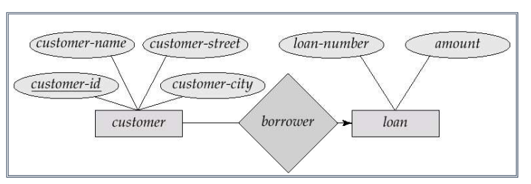
Many-to-One relationship (N – 1)

Slide 24
Many-to-Many relationship (N – N)
An entity in A is associated with more than one entities in B and an entity in B is associated with more than one entities in A.
Example: A customer is connected with more than one loan using borrower and a loan is connected with more than one customer using borrower.
customer
borrow
loan
A1
B1
C1
L1
A2
B2
C2
L2
C3
L3
A
B
C4
L4

Slide 25
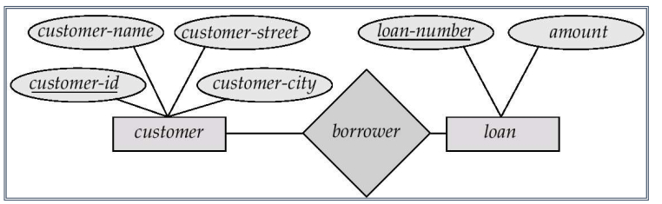
Many-to-Many relationship (N – N)

Slide 26
Mapping Cardinality (Cardinality Constraints) [Exercise]
Draw an E-R diagram and specify which type of mapping cardinality will be there in the following examples:
Each customer has only one account in the bank and each account is held by only one customer. [single account]
Each customer has only one account in the bank but an account can be held by more than one customer. [joint account]
A customer may have more than one account in the bank but each account is held by only one customer. [multiple accounts]
A customer may have more than one account in the bank and each account is held by more than one customer. [join account as well as multiple accounts]
A student can work in more than one project and a project can be done by more than one student.
A student can issue more than one book but a book is issued to only one student.
A subject is taught by more than one faculty and a faculty can teach more than one subject.

Slide 27
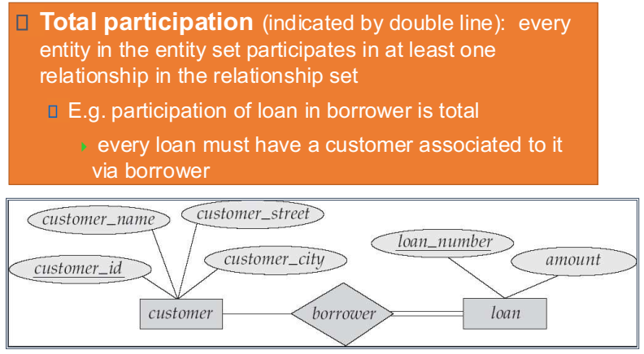
Participation of an Entity Set in a Relationship set

Slide 28
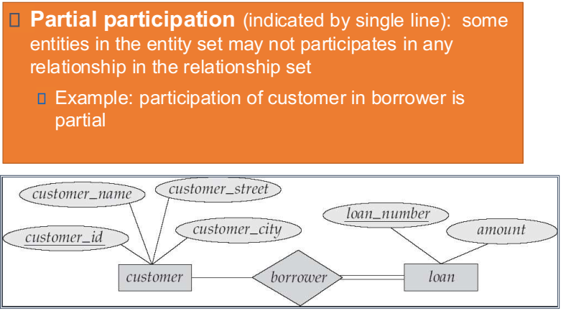
Participation of an Entity Set in a Relationship set

Slide 29
Representation of Cardinality in ER
The cardinality of a relationship is the actual number of related occurrences for each of the two entities.
E-R diagrams also provide a way to indicate cardinality of the relationship.
An edge between an entity set and a relationship set can have an associated minimum and maximum cardinality, shown in the form l..h, where l is the minimum and h the maximum cardinality.
A minimum value of 1 indicates total participation of the entity in the relationship.
A maximum value of 1 indicates that the entity participates in at most one relationship, while a maximum value * indicates no limit.
The label 1..* or 1..1 on an edge is equivalent to a double line.

Slide 30
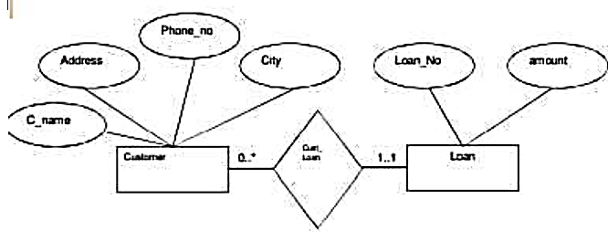
Representation of Cardinality in ER
The edge between Loan and Cust_Loan has a cardinality constraint of 1..1, meaning the minimum and the maximum cardinality are both 1.
That is, each loan must have exactly one associated customer.
The limit 0..* on the edge from Customer to Cust_Loan indicates that a customer can have zero or more loans.
Thus, the relationship Cust_Loan is one to many from customer to loan, and further the participation of loan in Cust_Loan is total.

Slide 31
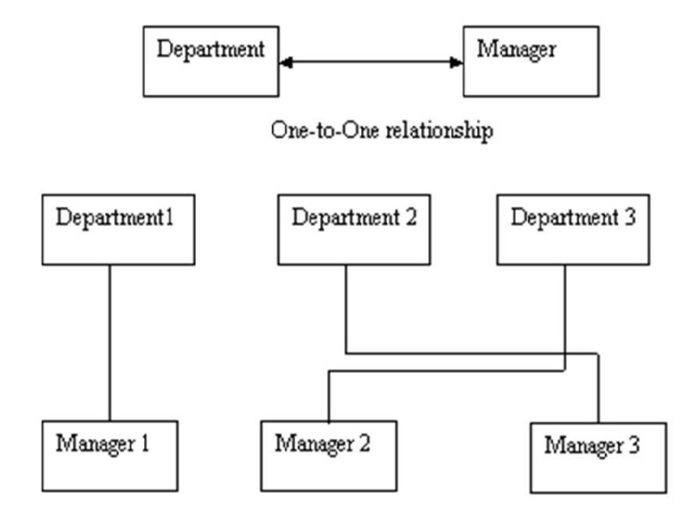
Direction Symbol
The direction of a relationship indicates the originating entity of a relationship.
The entity from which a relationship originates is the parent entity; the entity where the relationship terminates is the child entity.
The type of the relation is determined by the direction of line connecting relationship component and the entity.
To distinguish different types of relation, we draw either a directed line or an undirected line between the relationship set and the entity set.
Directed line is used to indicate one occurrence and undirected line is used to indicate many occurrences in a relation as shown in next case.

Slide 32
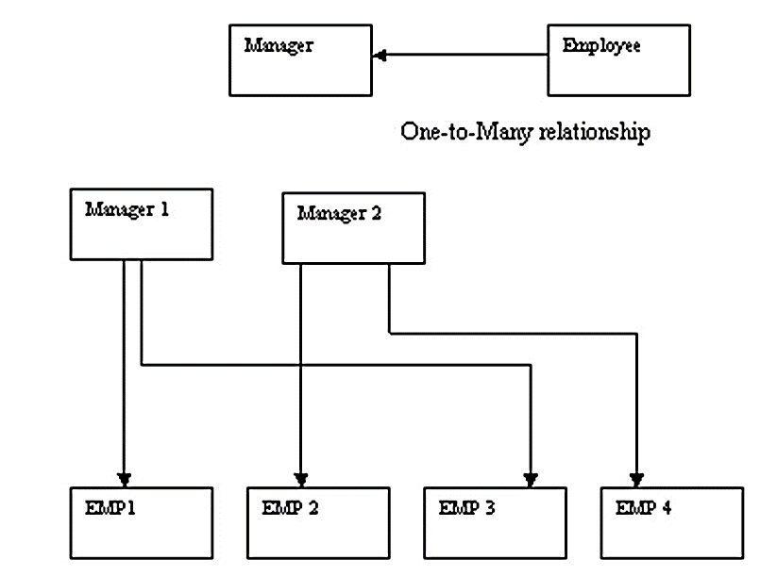
Direction Symbol

Slide 33
Weak Entity Set
The entity set which does not has sufficient attributes to form a primary key is called as weak entity set. An entity set that has a primary key is called as Strong entity set.
Payment-date
loan-no
amount
payment-no
Payment-amount
loan
L_P
payment
Strong Entity Set
Weak Entity Relationship
Weak Entity Set
Weak entity set is indicated by double rectangle.
Weak entity relationship set is indicated by double diamond.

Slide 34
Weak Entity Set
A member of a strong entity set is called dominant entity and member of weak entity set is called as subordinate entity.
A weak entity set does not have a primary key but we need a means of distinguishing among all those entries in the entity set that depend on one particular strong entity set.
i.e. the existence of a weak entity set depends on the existence of a strong entity set.
The primary key of a weak entity set is created by combining the primary key of the strong entity set on which the weak entity set existence depends and the weak entity set’s discriminator.
For example, payment_no is acts as discriminator for payment entity set. It is also called as the Partial key of the entity set.

Slide 35
Superclass and Subclass
Super Class | Sub Class
A superclass is an entity from which another entities can be derived. | A subclass is an entity that is derived from another entity.
E.g, an entity account has two subsets saving_account and current_account So an account is superclass. | E.g, saving_account and current_account entities are derived from entity account. So saving_account and current_account are subclass.
Account
Super Class
Saving_Account
Current_Account
Sub Class

Slide 36
Generalization
A generalization hierarchy is a form of abstraction that specifies that two or more entities that share common attributes can be generalized into a higher-level entity type called a super type or generic entity.
The lower level of entities becomes the subtype, or categories, to the super type. Subtypes are dependent entities.
Generalization is used to emphasize the similarities among lower-level entity sets and to hide differences.
It makes ER diagram simpler because shared attributes are not repeated.
Generalization is denoted through a triangle component labeled ‘IS_A”,
Bottom Up Approach.

Slide 37
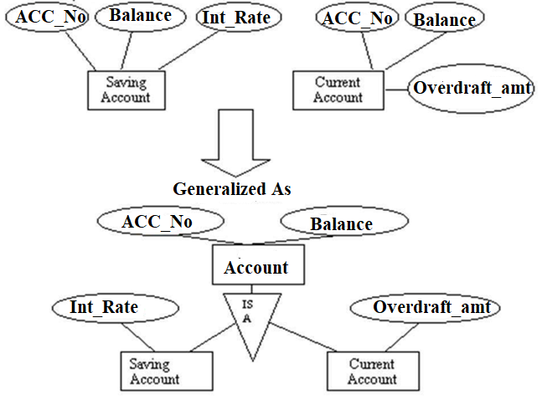
Generalization

Slide 38
Specialization
Specialization is the process of taking subsets of a higher-level entity set to form lower level entity sets.
It is a process of defining a set of subclasses of an entity type, which is called as super class of the specialization.
The process of defining subclass is based on the basis of some distinguish characteristics of the entities in the super class.
Top Down Approach
For example,
specialization of the Employee entity type may yield the set of subclasses namely Salaried_Employee and Hourly_Employee on the method of pay

Slide 39
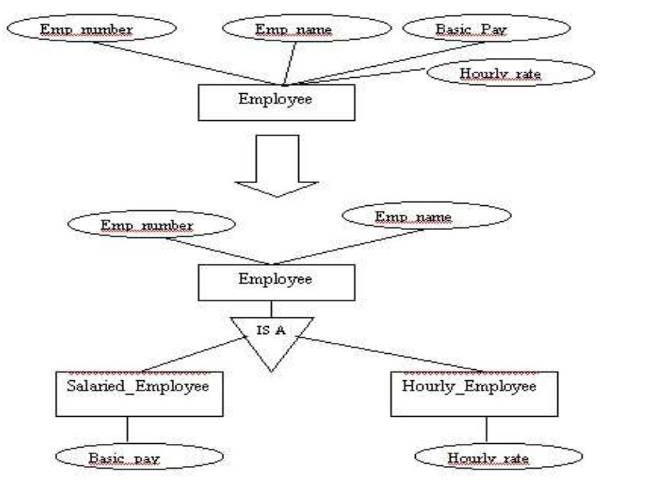
Specialization

Slide 40
Generalization and Specialization
Generalization | Specialization
It extracts the common features of multiple entities to form a new entity. | It splits an entity to form multiple new entities that inherit some feature of the splitting entity.
Name
Address
Name
Address
SPI
Salary
Person
Person
Name
Name
ISA
ISA
Bottom-up approach
Top-down approach
Address
Address
Student
Faculty
Student
Faculty
SPI
Salary
SPI
Salary

Slide 41
Generalization v/s Specialization
Generalization | Specialization
The process of creation of group from various entities is called generalization. | The process of creation of sub-groups within an entity is called specialization.
It is Bottom-up approach. | It is Top-down approach.
The process of taking the union of two or more lower level entity sets to produce a higher level entity set. | The process of taking a sub set of higher level entity set to form a lower level entity set.
It starts from the number of entity sets and creates high level entity set using some common features. | It starts from a single entity set and creates different low level entity sets using some different features.

Slide 42
Generalization & Specialization example
Name
Address
PID
City
Person
ISA
Salary
Employee
Customer
Balance
ISA
Full Time
Part Time
Days Worked
Hour Worked

Slide 43
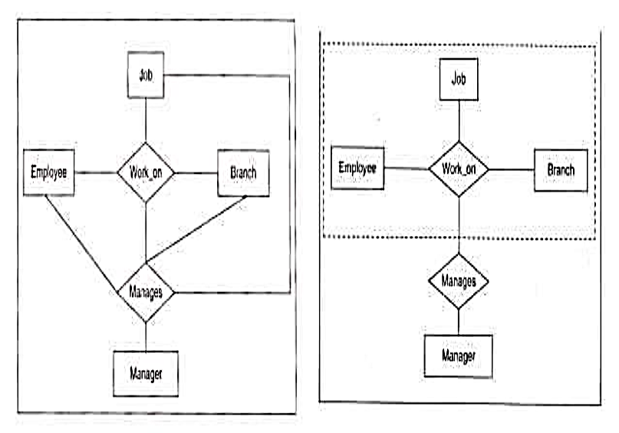
Aggregation
One limitation of the E-R model is that it cannot express relationships among relationships.
The best way to model a situation like this is by the use of aggregation.
Thus, the relationship set work_on relating the entity sets Employee, Branch and Job is a higher-level entity set.
Such an entity set is treated in the same manner, as is any other entity set.
We can then create a binary relationship Manages between work_on and Manager to represent who manages what tasks.

Slide 44
Aggregation: Example 2
Consider the ternary relationship proj_guide, which we saw earlier
Suppose we want to record evaluations of a student by a guide on a project
Relationship sets eval_for and proj_guide represent overlapping information
Every eval_for relationship corresponds to a proj_guide relationship
However, some proj_guide relationships may not correspond to any eval_for relationships
So we can’t discard the proj_guide relationship
Eliminate this redundancy via aggregation
Treat relationship as an abstract entity
Allows relationships between relationships
Abstraction of relationship into new entity

Slide 45
Aggregation: Example 2
Eliminate this redundancy via aggregation without introducing redundancy, the following diagram represents:
A student is guided by a particular instructor on a particular project
A student, instructor, project combination may have an associated evaluation
Reduction to Relational Schemas
To represent aggregation, create a schema containing
Primary key of the aggregated relationship,
The primary key of the associated entity set
Any descriptive attributes
In our example:
The schema eval_for is:
eval_for (s_ID, project_id, i_ID, evaluation_id)
The schema proj_guide is redundant.
Notes:
45

Slide 46
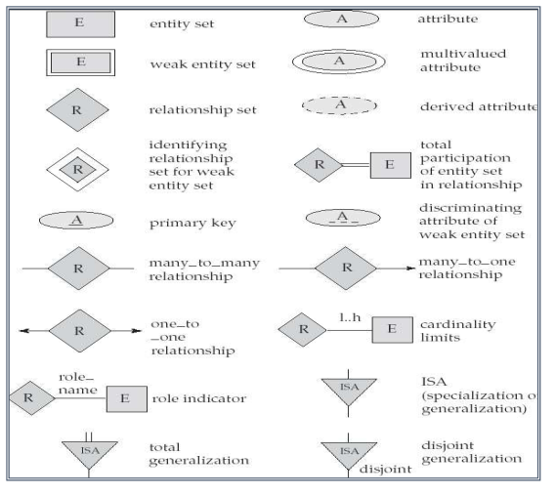
E-R Notation

Slide 47
Steps to design E-R diagram
Identify the Entities.
Find relationships among these entities.
Identify the key attributes for every Entity.
Identify other relevant attributes
Draw the complete e-r diagram with all attributes including the primary key

Slide 48
E-R diagram of Hospital Management System
MRID
PatID
Name
HosID
Name
Medical Record
Has
Patient
Admitted
Hospital
Report Name
ISA
Has
Treats
Indoor
Outdoor
Doctor
RoomNo
IPDID
OPDID
DrID
Dr Name
Charge

Slide 49
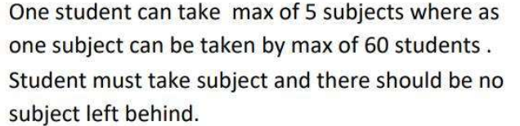
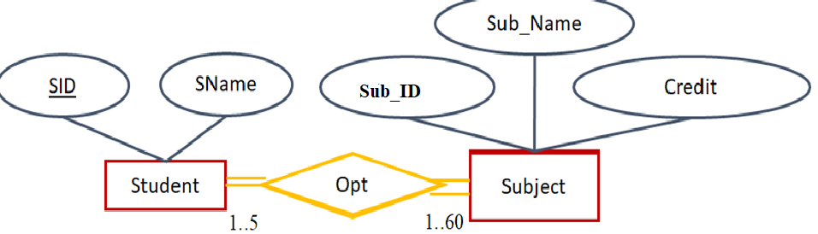
Question: Draw ER Diagram

Slide 50
Case Study 1: University Management System
Consider, a university contains many departments. Each department can offer any number of courses. Many teachers can work in a department. A teacher can work only in one department. For each department there is a Head. A teacher can be head of only one department. Each teacher can take any number of courses. A student can enroll for any number of courses. Each course can have any number of students.
Step1: Identify the Entities as
University,
Department,
Course,
Teacher,
Student
Note: Consider University as single instance
Step 2: Relationship:
Department and course (1:M)
Department & teacher(1:M)
Department Head and teacher(1:1)
Teacher and course(1:M)
Student & course(M:M)
Step 3: Key Attributes:
D_no,
C_code,
Roll_no,
t_code
Step 4: Relevant Attributes:
d_name,loc, c_name, credits, t_name, mob_no, name, address etc.

Slide 51
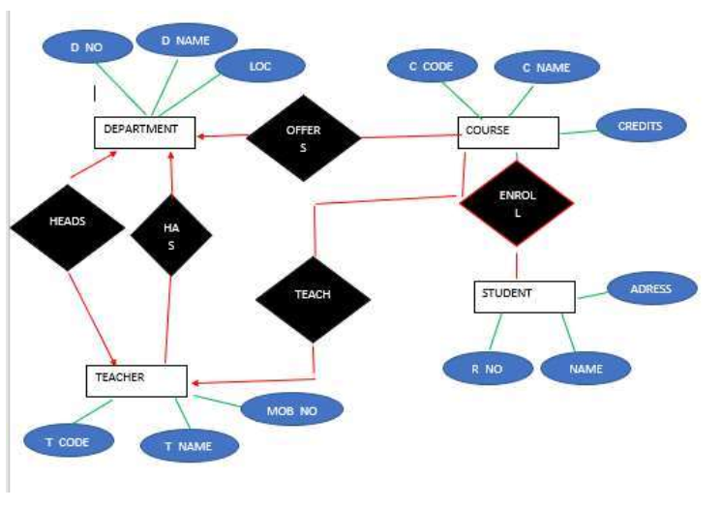
Case Study 1: University Management System, Cont’d...
Solution:

Slide 52
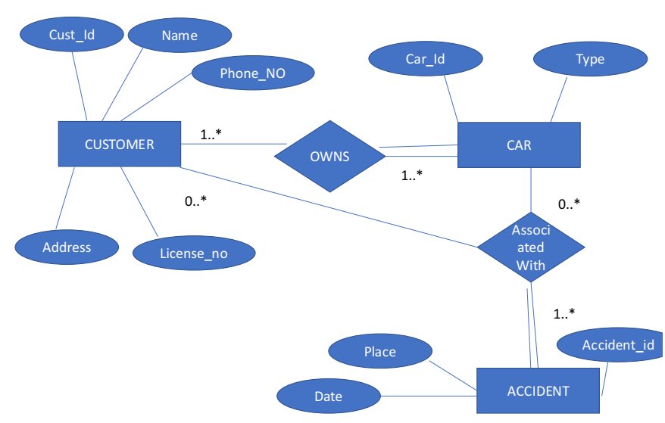
Case Study 2: Car Insurance System
Construct an ER diagram for a car insurance company whose customers own one or more cars each. Each car has associated with it zero to any number of recorded accidents. Solution:

Slide 53
Case Study 3: Banking Management System
Banks are identified by a name, code, address of main office.
Banks have branches.
Branches are identified by a branch_no., branch_name, address.
Customers are identified by name, cust-id, phone number, address.
Customer can have one or more accounts.
Accounts are identified by account_no., acc_type, balance.
Customer can avail loans.
Loans are identified by loan_id, loan_type and amount.
Account and loans are related to bank’s branch.

Slide 54
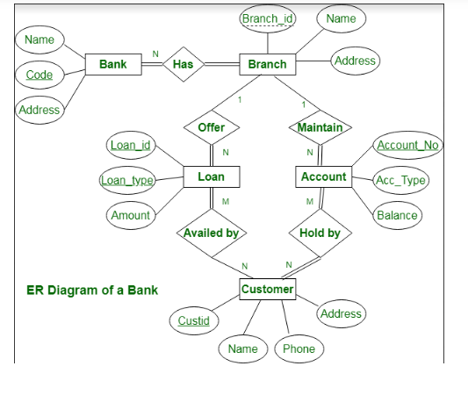
Banking Management System, Cont’d…

Slide 55
Case Study 4: The Library Management System
The system keeps track of the staff with a single point authentication system comprising
login Id
password
Staff maintains the book catalog with its ISBN, Book title, price(in INR), category(novel, general, story), edition, author Number and details.
A publisher has publisher Id, Year when the book was published, and name of the book.
Readers are registered with their user_id, email, name (first name, last name), Phone no (multiple entries allowed), communication address.
The staff keeps track of readers.
Readers can return/reserve books that stamps with issue date and return date. If not returned within the prescribed time period, it may have a due date too.
Staff also generate reports that has readers id, registration no of report, book no and return/issue info.

Slide 56
The Library Management System, Cont’d…
Entities and their Attributes –
Book Entity :
It has authno, isbn number, title, edition, category, price.
ISBN is the Primary Key for Book Entity.
Reader Entity :
It has UserId, Email, address, phone no, name.
Name is composite attribute of firstname and lastname.
Phone no is multi valued attribute.
UserId is the Primary Key for Readers entity.
Publisher Entity :
It has PublisherId, Year of publication, name.
PublisherID is the Primary Key.

Slide 57
The Library Management System, Cont’d…
Authentication System Entity :
It has LoginId and password with LoginID as Primary Key.
Reports Entity :
It has UserId, Reg_no, Book_no, Issue/Return date. Reg_no is the Primary Key of reports entity. Staff Entity : It has name and staff_id with staff_id as Primary Key.
Reserve/Return Relationship Set : It has three attributes: Reserve date, Due date, Return date.
Relationships between Entities – A reader can reserve N books but one book can be reserved by only one reader. The relationship 1:N.A publisher can publish many books but a book is published by only one publisher. The relationship 1:N.Staff keeps track of readers. The relationship is M:N.Staff maintains multiple reports. The relationship 1:N.Staff maintains multiple Books. The relationship 1:N.Authentication system provides login to multiple staffs. The relation is 1:N.

Slide 58
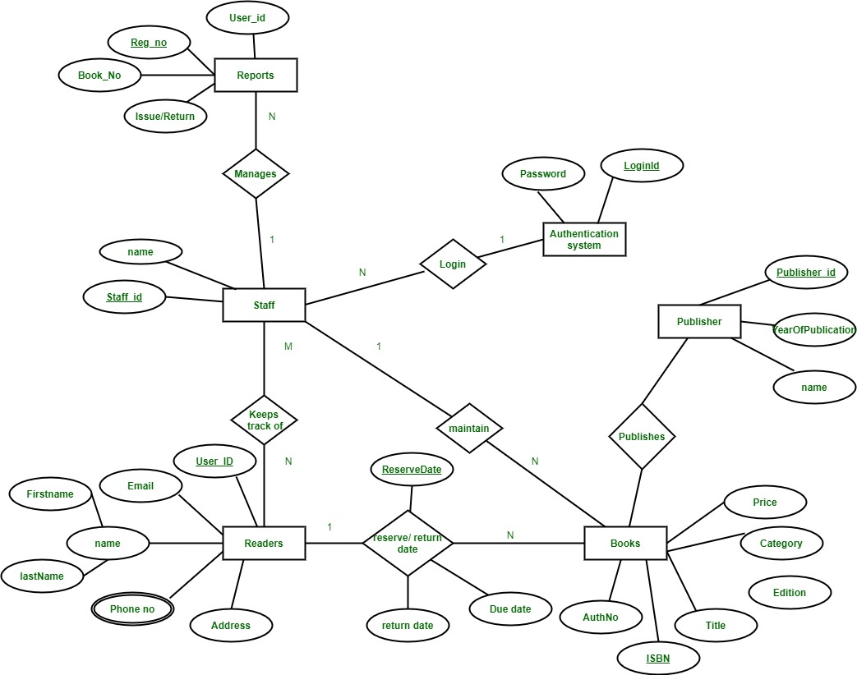
The Library Management System, Cont’d…

Slide 59


